Slide 1
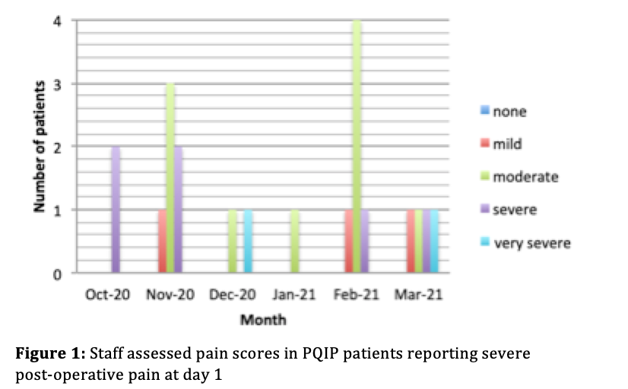
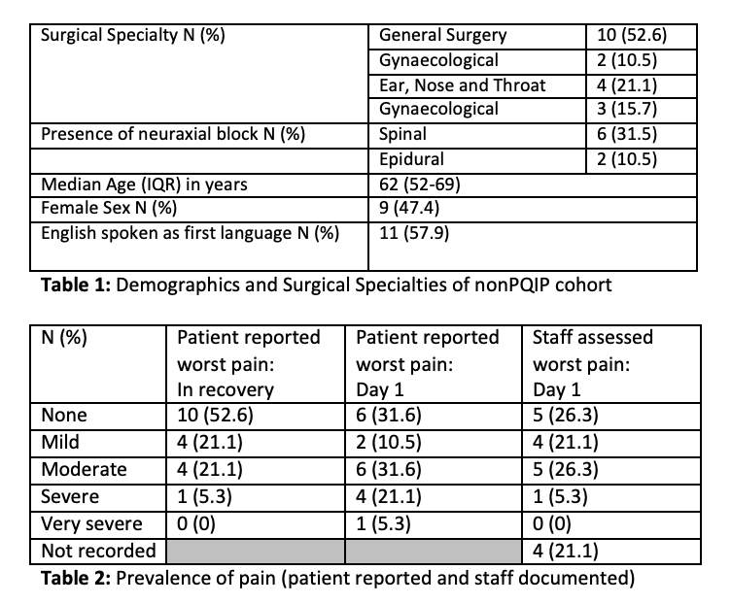
Patient experience of severe pain: Identifying barriers to improvement Sophie Hunter and Samantha Warnakulasuriya University College London Hospital
Methods
This project was carried out as part of a Quality Improvement Project approved by the departmental audit lead. The NHS HRA decision tool indicated that research ethics approval was not required. PDSA methodology has been used.
PQIP cohort: Data from PQIP patients reporting severe pain between October 2020 and March 2021 was evaluated. Patient reported pain was compared to that documented on Epic.
Non PQIP cohort: Stakeholder feedback was used to design a survey of patients who verbally consented to take part in this evaluation. Patients undergoing elective inpatient surgery were approached on a random basis to answer our survey postoperatively in April 2021. Data was collected on demographics, operation performed, anaesthetic block use, patient reported pain (recovery and first 24 hours) and documented pain (recovery and first 24 hours). Pain was defined using the five-point verbal descriptor rating scale (VDRS): no pain, mild, moderate, severe, very severe. Patients were asked to comment on the timing of incidence of pain. Pain scores were compared to the electronic health record.
Data was analysed using Microsoft Excel (Microsoft Corporation, Washington, USA)
Introduction
Twenty one percent of patients in the Perioperative Quality Improvement Programme (PQIP) report severe pain during the first 24 hours following surgery, therefore individualised pain management forms one of the PQIP’s top five national priorities (1). Locally, we have shown that the incidence of patient reported severe pain at day 1 postoperatively can be as high as 39% (2). Previous work indicated discordance between patient reported pain and that which is documented in the Epic electronic health record (EHR) (Epic systems, Wisconsin, USA) (2). The aim of this project was to further investigate patient experience of severe pain and to identify barriers to accurate assessment of pain, in order to inform the project team of targets for quality improvement.
Results
Figure 1 illustrates staff assessed scores amongst PQIP patients.
20 patients were interviewed in April 2021 for the non PQIP cohort. One patient was excluded as he had his operation at a different hospital. Surgical specialties and demographic data are presented in table 1. Prevalence of different levels of patient reported and staff assessed pain are presented in table 2.
Four patients had no pain scores recorded at day 1 on Epic (2 of whom were ventilated in this period). Concordance between patient reported pain and EPIC reported pain remained poor, with 11/15 patients reporting a different worst level of pain than that documented over that period of 24 hours in EPIC. 9/15 (60.0%) of patients reported worse pain than that documented by hospital staff in observations. The modal pain score recorded on EPIC was no pain for the majority (9/15) of patients.
Discussion
Our data supported previous work indicating significant proportions of patients experience severe pain. Lack of concordance between patient reported pain and staff assessed pain remains a concern. Our small sample did not support the hypothesis that a language barrier was contributing to discordance.
These results show that we need to improve pain documentation. The EHR is complex, reflected by the missing pain scores in recovery. When commenting on when their pain was worst, only one patient felt it was worst in recovery. The majority of patients reported that pain was worst on day 2 and 3, indicating the importance of ongoing input which is achieved in most hospitals through utilisation of an acute pain team.
Acknowledgements: Dr Jamie Smart for advice on QI targets
References:
Moonesinghe SR, Aresu G, Bampoe S, et al. Perioperative Quality Improvement Programme Annual Report 2018-19. London: Royal College of Anaesthetists, 2019.
Ganatra S,English R, Harris J et al. Pain is it what the patient says it is? Anaesthesia. 2021; 76( supp 2): 16-165.
Of patients who reported English as their first language, 63.6 % (7/11) of day 1 scores were discordant (patient reported pain worse in 6). In those that reported their first language as other than English, this was 50% (4/8) (patient reported pain worse in 3).
There was no correlation between recovery pain scores and presence of an anaesthetic neuraxial block. Of patients reporting moderate/severe/very severe pain at day 1, 6/14 patients had received blocks.
When commenting on worst perioperative pain, two patients described worse pain pre-operatively than after surgery. 8/19 patients (42%) of patients describe their worst pain experience as being after the first 24 hours post-operatively.

